Slide 1
Week 14
Reporting and dashboards

Slide 2
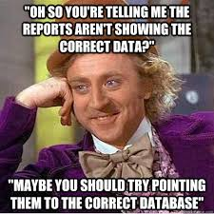
What are Database Reports
A database report is a way to see important info from the database
Reports can be done by hand or done automatically by the software that is running the database, or a combo of both
Reports can be done at assigned times or by a predetermined condition, and run by the software, or done by hand
Reports can be used for everything from sales data, to details about users, to totally customized drilled down data depending on what's needed

Slide 3
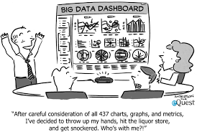
What is a dashboard
A dash board is a way to show information visually, it's made up of widgets
Widgets are a way to show small pieces of the data that are really important performance or metrics
You can have multiple dashboards for different audiences, for example, one for system metrics such as does the database have enough free space and memory that a DBA would want to care about. But then you can have another dashboard for users that would care about different things such as books checked out, or inventory levels.

Slide 4
Why we use reports and dashboards
We use reports for everything from presentations to C-suite people to compliance requirements
Reports are usually static pieces of information that are true for that moment in time
Dashboards are made of widgets, usually updated on a reliable time frame such as hourly, daily or weekly
Dashboards are good ways to keep track of things to see problems immediately and fix them, reports are good for seeing what happened or seeing where the system is at one point
Both will take metrics and performance and present them in different ways
Both take the data and present it in a structured coherent way so you can make informed decisions

Slide 5
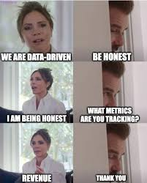
North Star Metric
Focus on the important information, don't clutter the visualization
Being able to identify ways to get rid of things on a dashboard is valuable, you don't want to have more information or the wrong information getting in the way
North Star Metric is a way to focus on the most important value without getting led astray
The North Star is your key measure for success, it's used commonly for product –led companies
Picking your North Star Metric is aligned with your customer values and product (also known as how the company says they are making the most money)

Slide 6
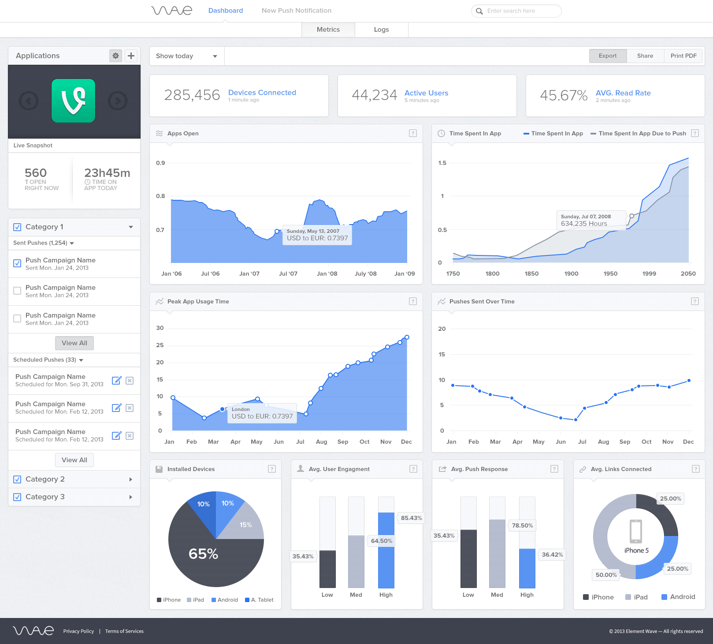
Example: Good report and Dashboard
Good Report
Good Dashboard
Clear purpose
Focused on the key metrics
Uses data visualizations to communicate important take aways from the data
Data is up to date, cleaned, and doesn't contain extraneous information
Includes an action item
https://www.matillion.com/blog/dashboard-examples-the-good-the-bad-and-the-ugly

Slide 7
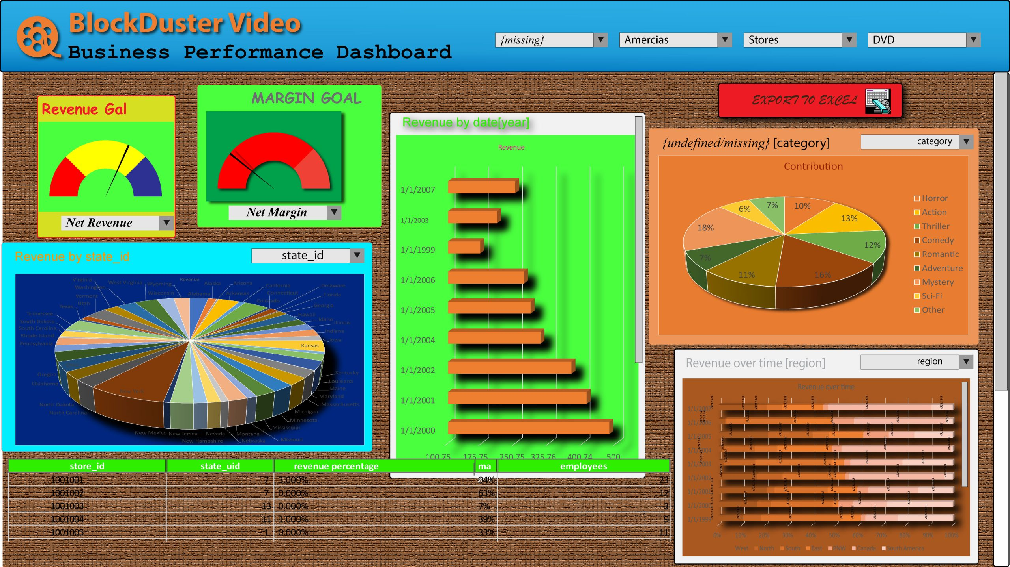
Example: Bad report and Dashboard
Bad Report
Bad Dashboard
Too much clutter
Too long
Shows raw data without context
Shows bad, inconsistent or old data
https://deliveringdataanalytics.com/i-tried-my-hand-at-designing-the-worst-dashboard-i-could-imagine/

Slide 8
Some different ways to have bad Dashboards
System metrics that are easy to make into a widget and are actually irrelevant such as I/O on a system that doesn't I/O
Multiple representations for the same concept, for example looking at both the books checked out and authors checked out, yes we can track both, but do we really care?
Proxy information instead of actual information, for example memory for book checkouts, yes it goes up with more people checking out books, but why not just look at book checkout numbers
Simulate a dashboard by running a report frequently and calling live information

Slide 9
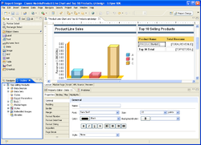
Some example reporting tools
Open Source options include Business Intelligence and Reporting Tools (BIRT) Project, and the ones built into LibreOffice Base
There are also tools that are sold such as Splunk, Tableau, ZoHo Analytics, Power BI Oracle. Some will have dashboard options as well as reports since they are both commonly used
https://en.wikipedia.org/wiki/BIRT_Project#/media/File:Eclipse_BIRT_Report_Designer.png

Slide 10
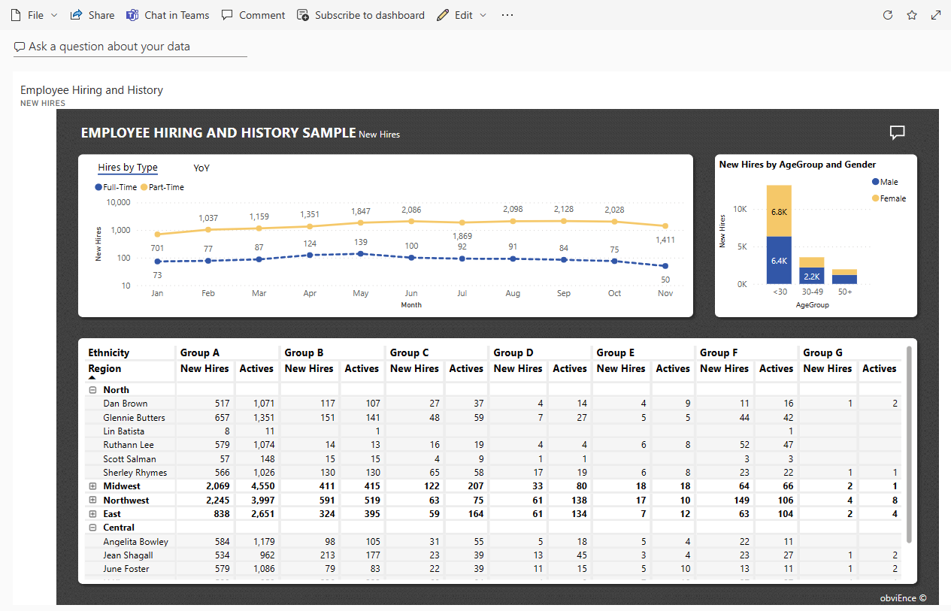
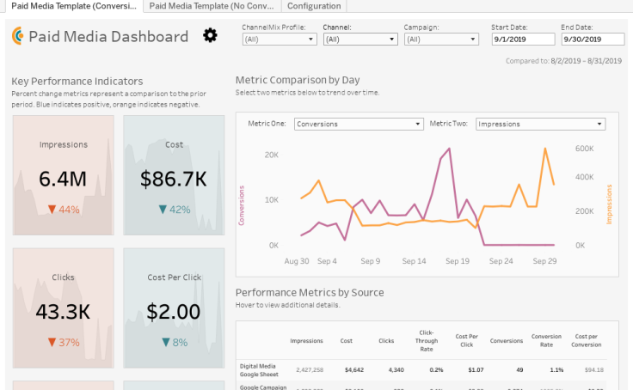
Some example dashboards
https://learn.microsoft.com/en-us/power-bi/create-reports/sample-dataset
https://www.tableau.com/dashboard/dashboard-examples
Other examples include: Oracle Analytics Cloud, Domo and AWS QuickSight

Slide 11
How to pick if you need a dashboard or a report or both
Dashboard
Report
You need updating information
You need to watch over time for key metrics
You need to see problems before they happen
You need alerts for key metrics and/or performance
You need to turn in information from a snapshot in time
You need to turn in a summary for a meeting or compliance requirement
You need to look at why a problem happened and do a post mortem
You need static information/data

Slide 12
Some example use cases
Report – Giving a presentation or Executive summary of a database to higher ups in a company
Dashboard – Keep track of the VM running the database to make sure there aren't provisioning issues and no slow downs
Report – Analyse specific issues that are going on, such as healthcare appointments being scheduled too frequently
Dashboard – Monitor health of code release
Report – Compliance, most places that have to follow compliance laws and regulations for their industry are required or strongly encouraged to turn in reports that correspond to the stated findings
Dashboard – Predicting issues before they happen, such as trying to head off support tickets before customers can complain

